Slide 1

Face recognition attendance system
Jspm’s jayawantrao sawant college of engineering
Project by:- Prabhanjan Dhobale
Guide name:- Prof. Swayam Shah

Slide 2

Company profile
Post – Data Analyst.
Company Description - Gamaka AI Solution is a premier company specializing in data science and analytics. We harness the power of artificial intelligence and advanced analytics to provide actionable insights, optimize operations, and enhance decision-making. Our team of experts and state-of-the-art technologies enable businesses to unlock the full potential of their data, gaining a competitive edge in the market. From data collection to modeling and visualization, we deliver tailored solutions across various industries, empowering organizations to make informed, data-driven decisions that drive success.

Slide 3
Project Overview
Our face-recognition student attendance system revolutionises traditional attendance management in educational institutions. By leveraging cutting-edge facial recognition technology, the system automatically identifies and records students' attendance in real-time. This eliminates the need for manual attendance taking, reduces errors, and enhances efficiency. The system securely stores and analyses facial features, ensuring reliable identification and preventing unauthorised access. With a user-friendly interface, teachers and administrators can easily monitor attendance records, generate reports, and track attendance patterns. Our face recognition student attendance system offers a seamless and reliable solution, saving valuable time and resources while promoting a safer and more efficient learning environment.

Slide 4
Existing system
Currently, many educational institutions rely on manual methods to track student attendance. These methods include roll-call, sign-in sheets, or barcode scanning, which are labor-intensive and prone to errors. These systems lack the ability to verify the identity of students accurately, leading to proxy attendance and potential security breaches. Additionally, manual data entry and record-keeping make it difficult to generate comprehensive attendance reports and analyze attendance patterns. The absence of automation hampers the efficiency and effectiveness of attendance management. To address these limitations, a more advanced solution like a face recognition student attendance system is necessary, providing accurate, secure, and automated attendance tracking.

Slide 5
Proposed system
Our proposed face recognition student attendance system aims to revolutionize attendance management in educational institutions. Leveraging state-of-the-art facial recognition technology, the system will automatically identify and record students' attendance in real-time, eliminating the need for manual methods. The system will securely store and analyze facial features, ensuring reliable identification and preventing proxy attendance. A user-friendly interface will allow teachers and administrators to easily monitor attendance records, generate comprehensive reports, and analyze attendance patterns. The proposed system will offer a seamless and efficient solution, saving valuable time and resources, enhancing security, and promoting a transparent and accurate attendance management process.

Slide 6
Scope of system
The scope of our face recognition student attendance system encompasses the development and implementation of a robust and scalable solution for educational institutions. The system will include features such as facial recognition algorithms, database management, real-time attendance tracking, and reporting functionalities. It will be designed to integrate seamlessly with existing student information systems and hardware infrastructure. The system will cater to multiple classrooms and campuses, accommodating a large number of students. It will also consider variations in lighting conditions and facial expressions to ensure accurate identification. The scope extends to providing user-friendly interfaces for teachers, administrators, and IT personnel, facilitating efficient attendance management processes.

Slide 7
UML Diagrams

Slide 8
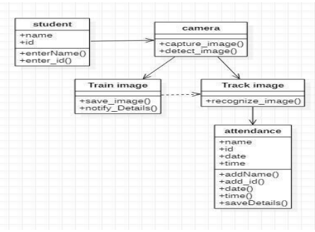
Class Diagram

Slide 9
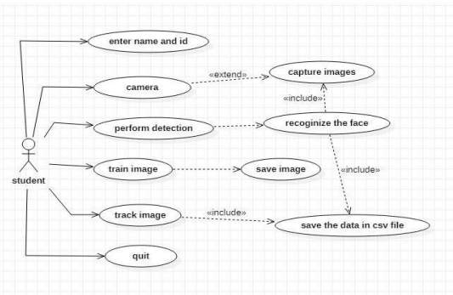
USE case Diagram

Slide 10
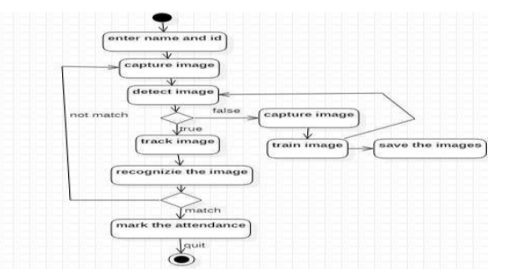
activity Diagram

Slide 11
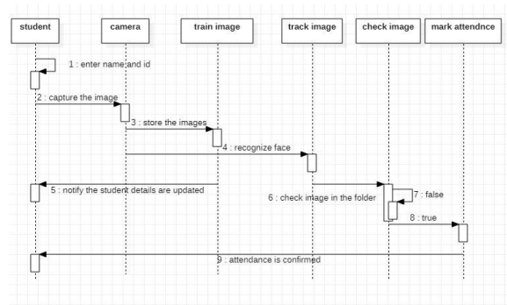
sequence Diagram

Slide 12
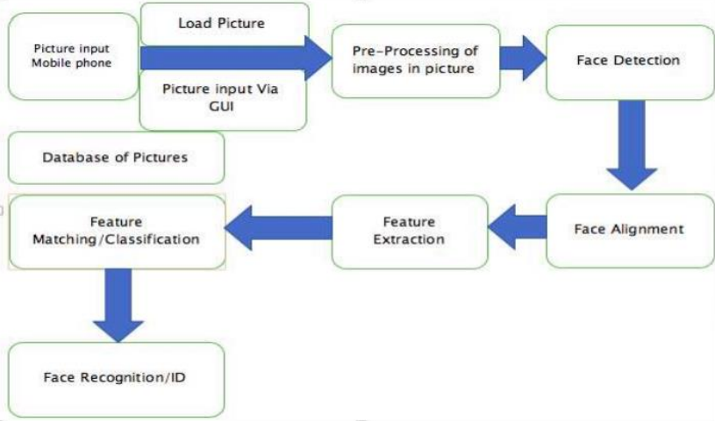
Working of application

Slide 13
Hardware and software requirement
Software Requirement
Language – Python
GUI Framework – PyQTpy
Database and File System – Azure Blob Storage (Un-structured) and csv file format.
Hardware Requirement
SSD – 256 GB Minimum OR
HDD – 512 GB Minimum
Cache – 2 MB Minimum
Operating System – Windows 7+, Linux any Flavour and Macintosh any version
Camera – 2 MP Minimum

Slide 14
Screen design

Slide 15
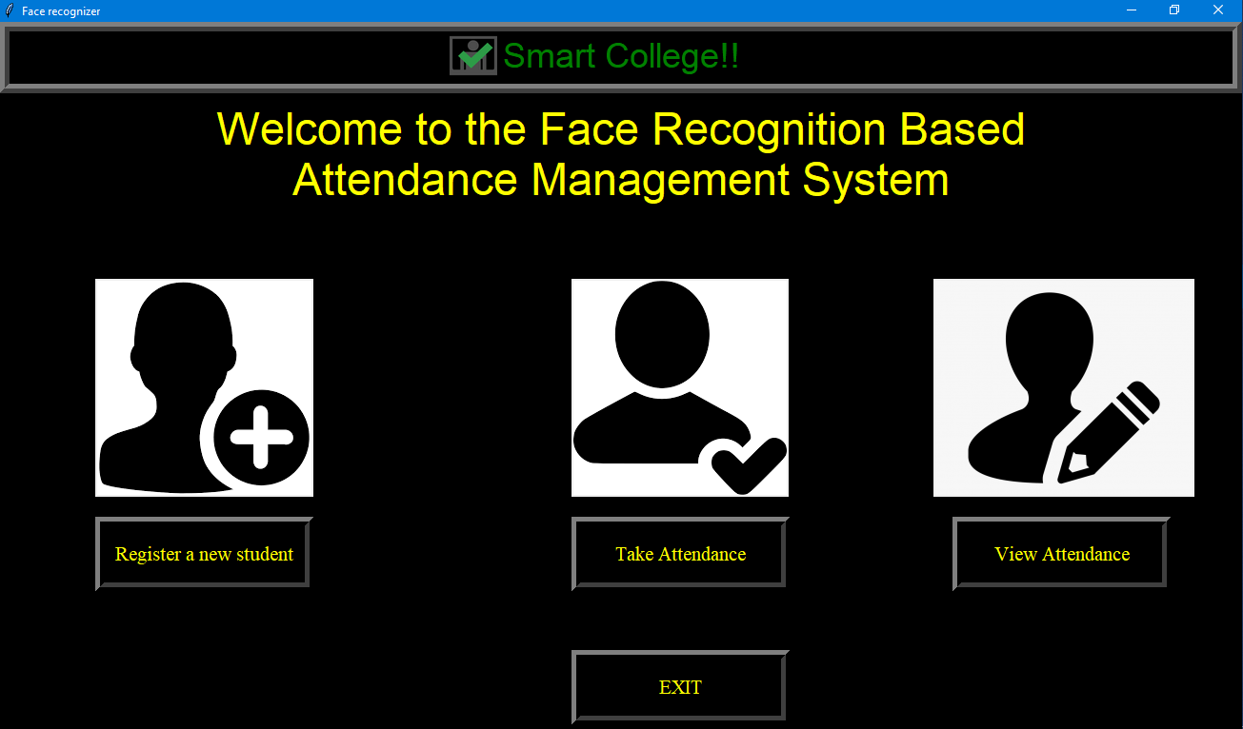

Slide 16
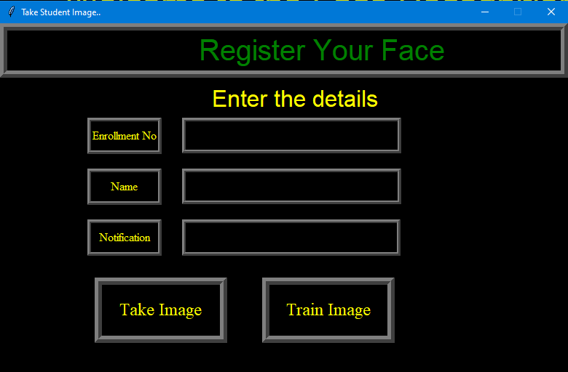

Slide 17
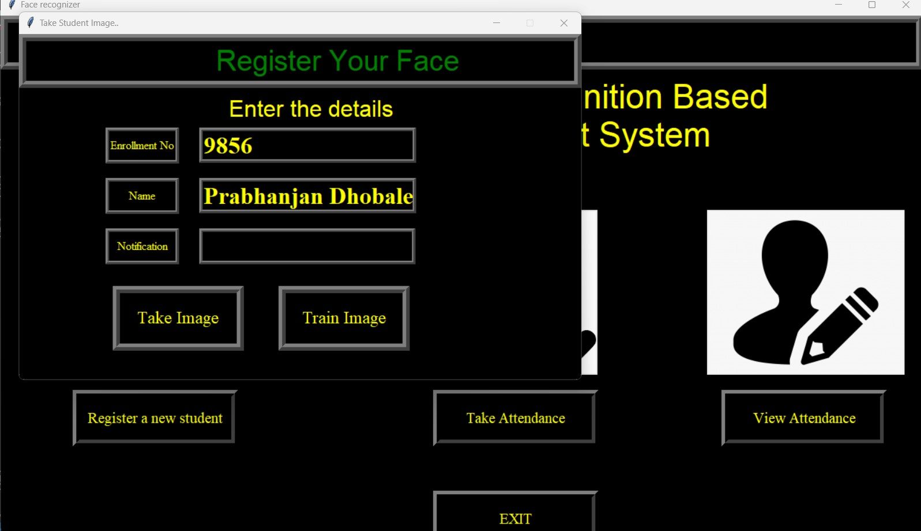

Slide 18
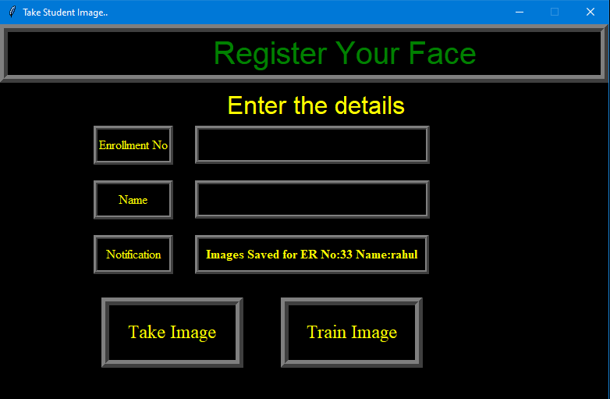

Slide 19
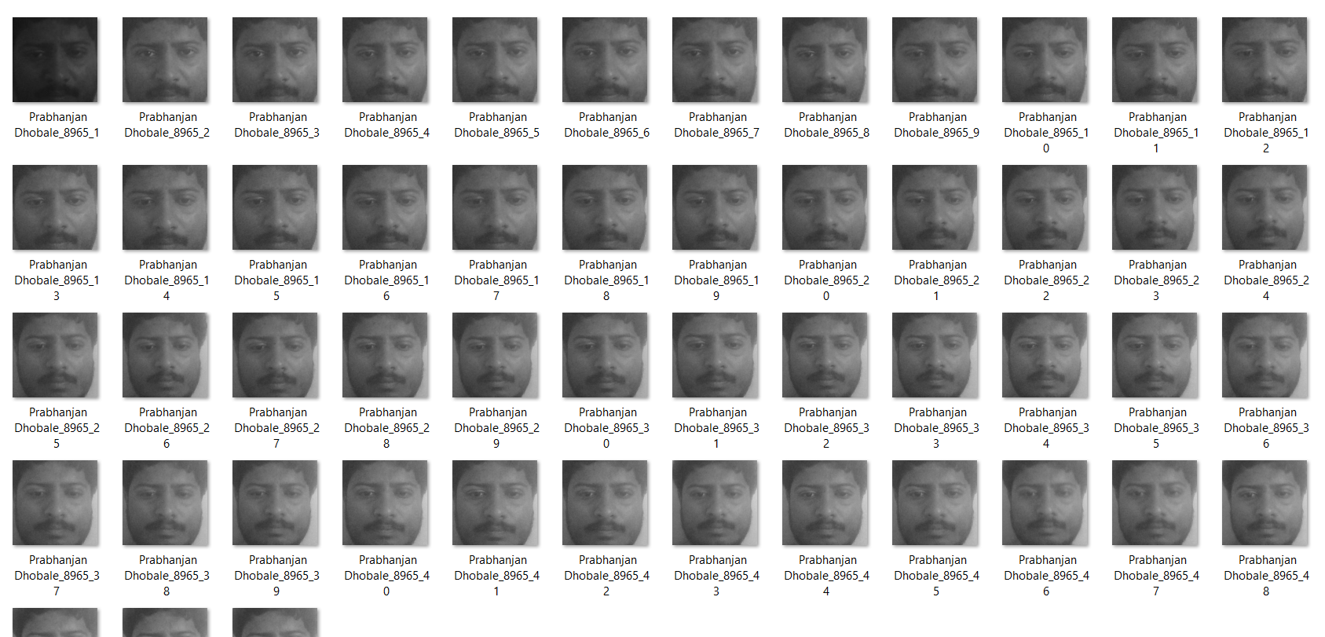

Slide 20
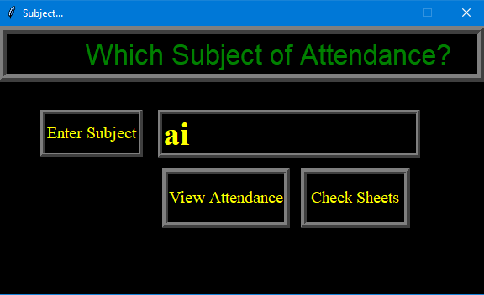

Slide 21
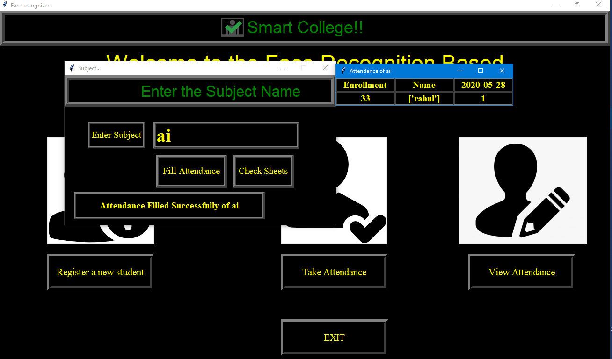

Slide 22
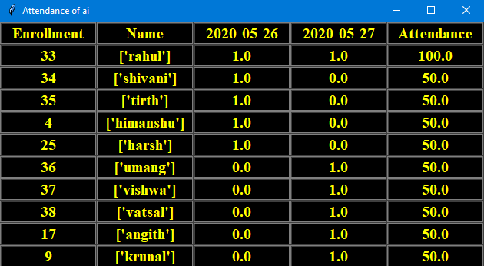

Slide 23
Test cases

Slide 24
Test Case 1:
Test Case Identifier: TC001
Test Case Description: Valid faces were recognised and attendance was recorded successfully.
Test Procedure:
Present the student's face to the face recognition system.
Verify if the system successfully recognises the student's face.
Check if the student's attendance is recorded.
Expected Result: Attendance is recorded for the student.
Test Case 2:
Test Case Identifier: TC002
Test Case Description: Invalid face recognised; attendance not recorded.
Test Procedure:
Present a random person's face to the face recognition system.
Verify if the system incorrectly recognises the random person's face as a student.
Check if the attendance is not recorded for the random person.
Expected Result: Attendance is not recorded for the random person.

Slide 25
Test Case 3:
Test Case Identifier: TC003
Test Case Description: Face recognition failure due to poor lighting conditions
Test Procedure:
Present the student's face to the face recognition system in low light.
Verify if the system fails to recognise the student's face due to poor lighting conditions.
Check if the student's attendance is not recorded.
Expected Result: Attendance is not recorded for the student.
Test Case 4:
Test Case Identifier: TC004
Test Case Description: Face recognition failure due to an obstructed view
Test Procedure:
Present the student's face to the face recognition system with partial obstruction.
Verify if the system fails to recognise the student's face due to an obstructed view.
Check if the student's attendance is not recorded.
Expected Result: Attendance is not recorded for the student.

Slide 26
Test Case 5:
Test Case Identifier: TC005
Test Case Description: Multiple faces are recognised, and the system prompts for manual selection.
Test Procedure:
Present two students standing close together to the face recognition system.
Verify if the system recognises multiple faces.
Check if the system prompts for manual selection of the correct student's face.
Manually select the correct student's face.
Check if the attendance is recorded for the selected student.
Expected Result: The system prompts for manual selection, and attendance is recorded for the selected student.
Test Case 6:
Test Case Identifier: TC006
Test Case Description: Face recognition failure due to changes in student appearance (e.g., hairstyle)
Test Procedure:
Present the student's face to the face recognition system with a changed appearance (e.g., a different hairstyle).
Verify if the system fails to recognise the student's face due to changes in appearance.
Check if the student's attendance is not recorded.
Expected Result: Attendance is not recorded for the student.

Slide 27
Test Case 7:
Test Case Identifier: TC007
Test Case Description: Face recognition failure due to facial expression change
Test Procedure:
Present the student's face to the face recognition system with different facial expressions.
Verify if the system fails to recognise the student's face due to a facial expression change.
Check if the student's attendance is not recorded.
Expected Result: Attendance is not recorded for the student.
Test Case 8:
Test Case Identifier: TC008
Test Case Description: Face recognition failure due to extreme angles
Test Procedure:
Capture the student's face from a severe side or top angle and present it to the face recognition system.
Verify if the system fails to recognise the student's face due to extreme angles.
Check if the student's attendance is not recorded.
Expected Result: Attendance is not recorded for the student.

Slide 28
Test Case 9:
Test Case Identifier: TC009
Test Case Description: System malfunction; face recognition is not functioning.
Test Procedure:
There is no face-to-face recognition system.
Verify if the system fails to detect any faces.
Check if the system displays an error message.
Verify if the attendance is not recorded.
Expected Result: An error message is displayed, and attendance is not recorded.
Test Case 10:
Test Case Identifier: TC010
Test Case Description: The system crashed during face recognition.
Test Procedure:
Present a student's face to the face recognition system.
Simulate a system crash during the face recognition process.
Check if the system restarts after the crash.
Verify if the attendance recording is interrupted temporarily.
Expected Result: The system restarts, and attendance recording is temporarily interrupted.

Slide 29
Thank you

